Slide 1
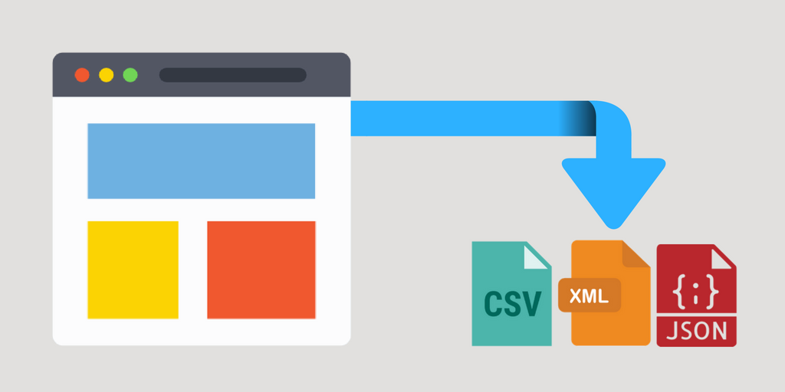
CSAI Web Scraping

Slide 2
What is web scraping?

Slide 3
What is web scraping?
A way to automatically extract data from a website

Slide 4
What is web scraping?
A way to automatically extract data from a website
In our case:
Data extraction by parsing the HTML of a page

Slide 5
What is web scraping?
A way to automatically extract data from a website
In our case:
Data extraction by parsing the HTML of a page
A last resort

Slide 6
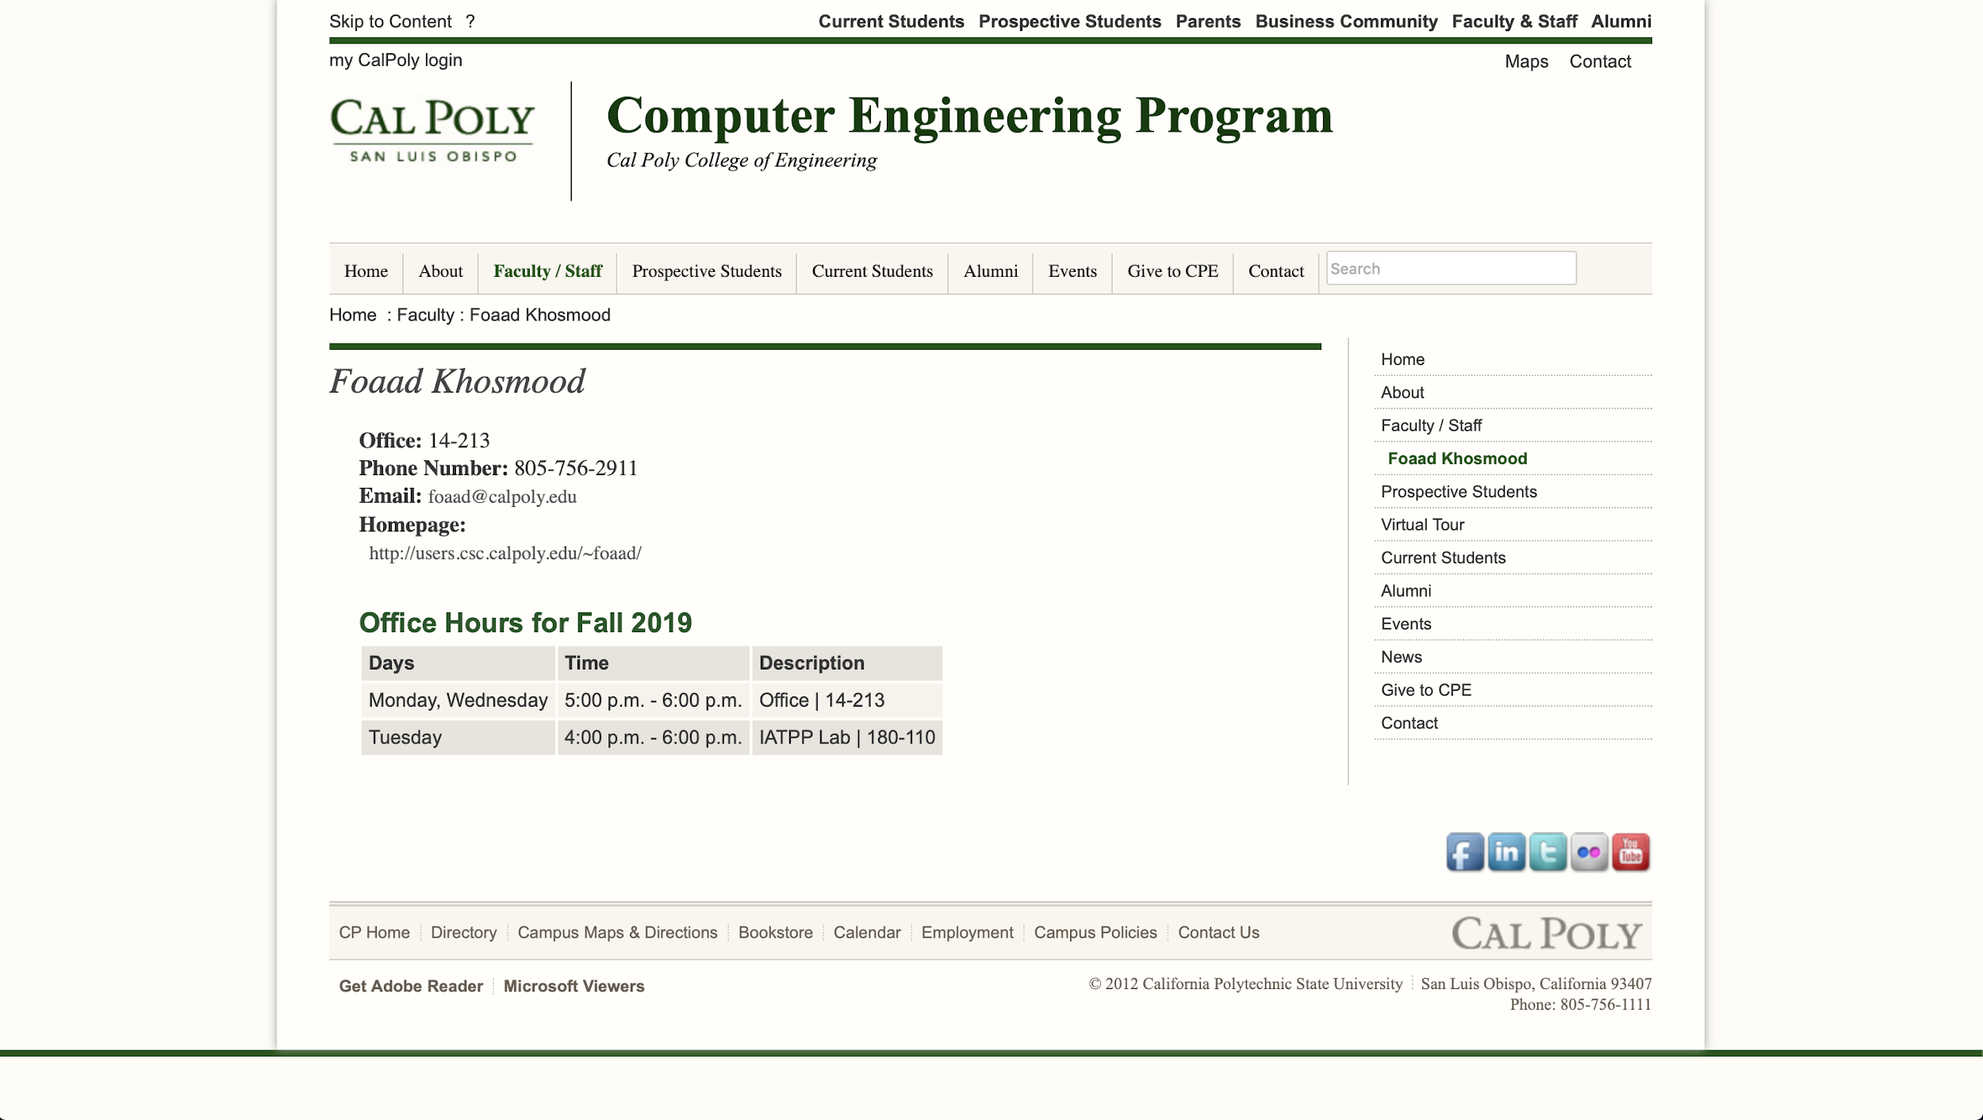

Slide 8
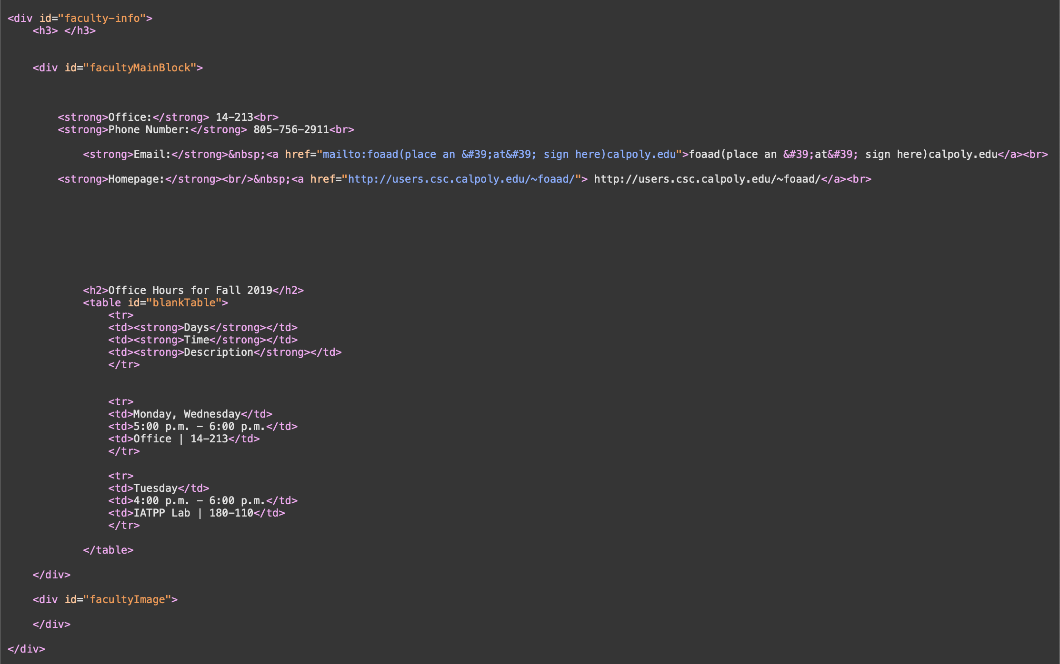

Slide 9



+
+
BeautifulSoup

Slide 10
Required Requests knowledge:
page = requests.get(url)

Slide 11
BeautifulSoup lets you explore a webpage as a tree
BeautifulSoup

Slide 12
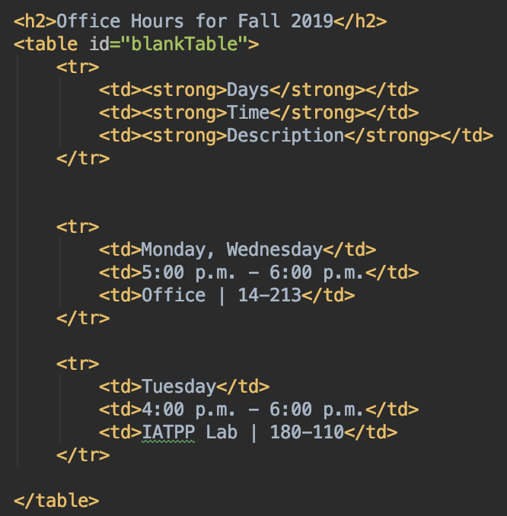
BeautifulSoup lets you explore a webpage as a tree
BeautifulSoup

Slide 13
BeautifulSoup lets you explore a webpage as a tree
<parent
<child1> txt1 </child1>
<child2> txt2 </child2>
</parent>
BeautifulSoup

Slide 14
Required BeautifulSoup knowledge:
soup = BeautifulSoup(page, ‘html.parser’)
item = soup.find(search_term)
items = soup.find_all(search_term)
item_text = item.text
BeautifulSoup

Slide 15


Data storage
Websites
Scrapers
Server
Scrapers pull data from websites and store it in a database. Nimbus downloads the database and uses it to answer questions.
Nimbus

Slide 16


Databases:
Google Firebase
SQL

Slide 17
Program structure
Master
Module
Module
Module
Wrapper
Wrapper
Wrapper

Slide 18
How can I help?

Slide 19
How can I help?
Learn Python, Requests, BeautifulSoup
Work on modules

Slide 20

Thank you!

